Slide 1
Quad Cities Veterans Outreach Center
Presented by QC Coders

Slide 2
Problem Statement
Using mardi gras tokens
Control access, prevent fraud
Reporting and record keeping

Slide 3
Solution
Electronic
Physical cards with barcodes
Barcode scanning with mobile devices
Photo capture with mobile devices

Slide 4





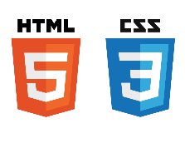

Architecture

Slide 5
Workflow and Pipeline
GitHub
Issues
Projects
Milestones

Slide 6
Pipeline
Git
GitHub
Travis CI
Deploy to AWS Lambda
Deploy to AWS S3
Manual database deployments
Manual google play deployments

Slide 7
Questions?

